Slide 1
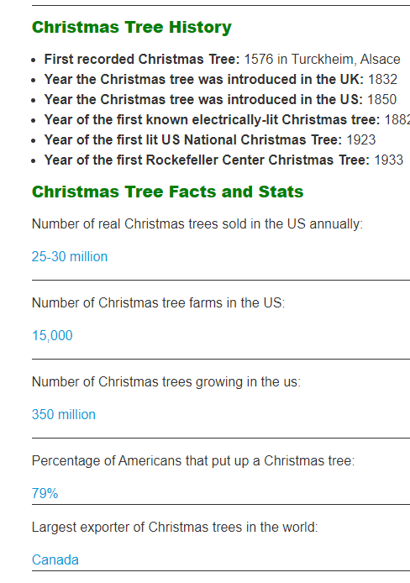
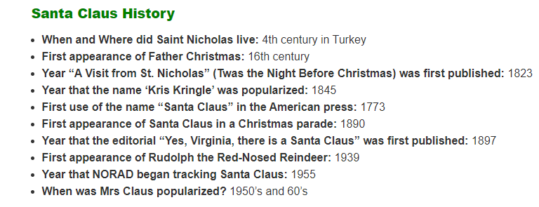
336 First Christmas in Rome
1834 First Time Bank holiday in UK
13 years : banned in England by the Puritans (1647 – 1660)
92% of Americans celebrate Christmas
51% of Americans see it as a religious holiday
$34,558.65 amt it would cost if you purchased in the 12 Days of Christmas
Avg amt spend on gifts:
$663.96 (Americans)
$522.56 (British)
1.6 Billion Number of Christmas card purchased annually
1843 First Commercial Christmas card
Notes:
- https://expandedramblings.com/index.php/10-things-you-didnt-know-about-christmas/
https://en.wikipedia.org/wiki/Saint_Nicholas - https://www.bctga.co.uk/mediapage/Christmas-Tree-Fun-Facts
- https://www.activesustainability.com/sustainable-life/carbon-footprint-natural-vs-plastic-christmas-tree/?_adin=02021864894
- https://www.christmastree.dk/en/did-you-know/nordmanns-fir-christmas-trees-bind-co2/

Slide 2
WHAT ARE THE DIFFERENT TYPES OF CHRISTMAS TREES?
Nordmann Fir
Noble Fir
Douglas Fir
Norway Spruce
Blue Spruce
Lodgepole Pine
Serbian Spruce
A real Christmas tree bought locally has the lowest carbon footprint.
The Carbon Trust say a real Christmas tree has a “much lower” carbon footprint than an artificial tree, particularly if it is disposed of thoughtfully.
They state that a natural two-metre Christmas tree without roots, disposed of into landfill generates a carbon footprint of around 16kg of CO2.
If the same sized tree is disposed of by burning it on a bonfire, planting it or having it chipped to spread on a garden, it will have a carbon footprint of around 3.5kg of CO2 – an impressive four and a half times less carbon footprint.
A two-metre Christmas tree made from plastic has a carbon footprint of around 40kg of CO2, over 10 times greater than that of a real tree, disposed of properly
Unlike artificial trees, a real Christmas tree naturally absorbs CO2 and releases oxygen and the Soil Association also highlights how a real tree provides a habitat for wildlife and captures carbon from the atmosphere during the 10-12 years they take to grow.
Unlike artificial trees, real trees can also be recycled. Many BCTGA members and local councils across the country offer Christmas tree collection services, where used Christmas trees are picked up and recycled.
There is no need to worry about deforestation when buying a natural Christmas tree, because the majority are grown by BCTGA members as a horticultural crop and are not felled from pre-existing forests.
When a Christmas tree is cut down, it is immediately replaced by another seedling, with up to 10 trees being planted for every average size tree that is grown.
40
Most trees are UK-grown, with only around £3 million worth of Christmas trees imported into the UK in 2017, according to government figures. However, recent statistics suggest that almost half of all trees sold are fake.
If we choose a plastic one, we will have to lengthen its lifespan for longer than 12 years so that it makes up for all those tonnes of CO2 emitted, and of course, we will have to make sure that it is properly recycled.

Slide 3









£3,000,000 worth of Christmas trees imported into the UK in 2017
25 – 30 Million
Real Christmas trees sold in the US annually
6 – 8 Million
Real Christmas trees sold in the UK annually
270
St. Nicholas was born
221ft
The world's tallest Xmas tree was erected in a Washington shopping mall in 1950.
336
First Christmas in Rome
15,000
Christmas trees farms in the US
16th Century
First appearance of father Chistmas
1576
First recorded Christmas Tree
350 Million
Christmas trees growing in the US
100 Million
Christmas trees growing in the UK
1773
First use of the name “Santa Claus” in the American press
1832
Christmas Tree introduced in UK
Canada
Largest exporter of Christmas trees in the world
1834
First Time Bank holiday in UK
1.6 Billion
1947
the tree in London’s Trafalgar Square has been a gift from the city of Oslo, Norway
Christmas card purchased annually
1843
First Commercial Christmas card
1850
Christmas Tree introduced in US
£28,116 to purchase in the 12 Days of Christmas
Avg amt spend on gifts:
£540 (US) £425(UK)
13 years
banned in England by the Puritans (1647 – 1660)
1882
First known eclectically-lit Christmas Tree
1939
First appearance of Rudolph the Red-nose Reindeer

Slide 4









CHRISTMAS TREES
1576
First recorded Christmas Tree
A QUICK LOOK AT THE NUMBERS
1832
Christmas Tree introduced in UK
1850
Christmas Tree introduced in US
£3,000,000
worth of Christmas trees imported into the UK in 2017
1882
First known eclectically-lit tree
1923
First US National Christmas Tree
1947
The first tree in London’s Trafalgar Square received as a gift from the city of Oslo, Norway
 | The number of real Christmas trees sold annually | The number of Christmas trees growing
US | 25 – 30 Million | 350 Million
UK | 6 – 8 Million | 100 Million
1933
First Rockefeller Center Tree
80%
of trees sold in the UK are Nordmann Fir
For a 2-metre-tall Christmas tree, with no roots, the carbon footprint is:
Kg CO2
Canada
is the largest exporter of Christmas trees in the world
16
of CO₂ is released by disposing of a real tree into landfill
12.2 tons
of CO₂ is absorbed annually per hectare planted
3.5
of CO₂ is released by disposing of a real tree by burning it on a bonfire, planting it or having it chipped
221ft
The world's tallest Xmas tree was erected in a Washington shopping mall in 1950
40
of CO₂ is released by the manufacture and transportation of a artificial tree
the average life cycle of a Christmas tree is
10 years
18 kg CO2
of CO₂ is accumulated by a real Christmas tree over its life span
Amy M. Collins (linkedin.com/in/amymmcollins)
Notes:
Data sources: - https://expandedramblings.com/index.php/10-things-you-didnt-know-about-christmas/
- https://www.carbontrust.com/news-and-insights/news/the-carbon-trusts-tips-for-a-more-sustainable-christmas
https://www.bctga.co.uk/mediapage/Christmas-Tree-Fun-Facts
https://www.activesustainability.com/sustainable-life/carbon-footprint-natural-vs-plastic-christmas-tree/?_adin=02021864894
https://www.christmastree.dk/en/did-you-know/nordmanns-fir-christmas-trees-bind-co2/

Slide 5
CHRISTMAS TREES
£3,000,000
worth of Christmas trees imported into the UK in 2017
80%
of trees sold in the UK are Nordmann Fir
A QUICK LOOK AT THE NUMBERS
1576
First recorded Christmas Tree
The number of real Christmas trees sold annually | The number of Christmas trees growing
25 – 30 Million | 350 Million | US
6 – 8 Million | 100 Million | UK
1832
Christmas Tree introduced in UK
1850
Christmas Tree introduced in US
1882
First known eclectically-lit tree
the average life cycle of a Christmas tree is
10 years
12.2 tons
of CO₂ is absorbed annually per hectare planted
1923
First US National Christmas Tree
1947
The first tree in London’s Trafalgar Square received as a gift from the city of Oslo, Norway
1933
First Rockefeller Center Tree
For a 2-metre-tall Christmas tree, with no roots, the carbon footprint is:
Kg CO2
16
is released by disposing of a real tree into landfill
Canada
is the largest exporter of Christmas trees in the world
3.5
is released by disposing of a real tree by replanting it or having it chipped
221ft
The world's tallest Christmas tree was erected in a Washington shopping mall in 1950
40
is released by the manufacture and transportation of a artificial tree
18
is accumulated by a real Christmas tree over its life span
Amy M. Collins (linkedin.com/in/amymmcollins)
Notes:
Data sources: - https://expandedramblings.com/index.php/10-things-you-didnt-know-about-christmas/
- https://www.carbontrust.com/news-and-insights/news/the-carbon-trusts-tips-for-a-more-sustainable-christmas
https://www.bctga.co.uk/mediapage/Christmas-Tree-Fun-Facts
https://www.activesustainability.com/sustainable-life/carbon-footprint-natural-vs-plastic-christmas-tree/?_adin=02021864894
https://www.christmastree.dk/en/did-you-know/nordmanns-fir-christmas-trees-bind-co2/

